Slide 1

An Intro to Wireless Sensor Networks (WSN)
Department of CSE, IUT

Slide 2

What is a WSN?
“A wireless sensor network (WSN) is a wireless network consisting of spatially distributed autonomous sensor devices to cooperatively monitor physical or environmental conditions (such as temperature, sound, vibration, pressure, motion or pollutants) , at different locations.”

Slide 3
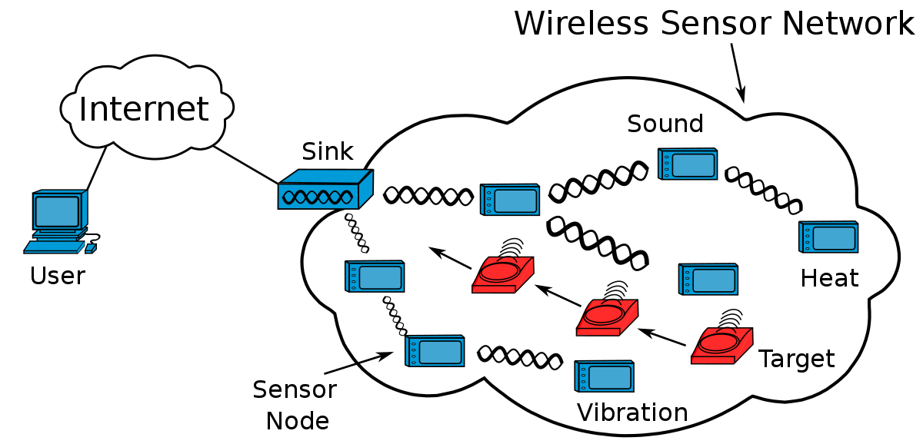
What is a WSN?
A Wireless Sensor Network (WSN) consists of
base stations (sink) &
several wireless sensors (nodes)

Slide 4

What is a WSN?
Consists of large amount of sensor nodes
Multi-hop and self-organizing
Wireless communication
Cooperative sensing, collection, processing
Monitors the environment or system by measuring physical parameters such as temperature, pressure, humidity

Slide 5
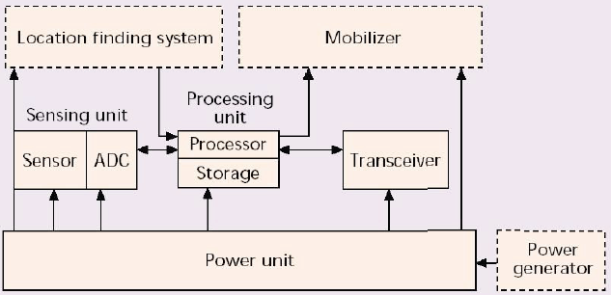
Components of a WSN Device/Node

Slide 6
Ad Hoc Wireless Networks
Large number of self-organizing static or mobile nodes that are usually deployed in a random way
Near(est)- neighbor communication
Wireless Connections
Links are fragile, possibly asymmetric
Connectivity depends on power levels and fading
Interference is high for unidirectional antennae
Sensor Networks and Sensor-Actuator Networks are a prominent example of Ad Hoc Networks.

Slide 7
Characteristics of WSNs
Requirements: small in size, large in number, tether-less, and low cost
Constraints: energy, computation, and communication
Small size implies small battery, low cost and energy implies low power CPU and radio, with minimum bandwidth and range
Ad-hoc deployment implies no maintenance or battery replacement
To increase network lifetime, no raw data is transmitted
Wireless sensor nodes can be deployed in extreme environmental conditions and may be prone to enemy attacks.
Although deployed in an ad hoc manner, they need to be self organizing and self healing and can face constant reconfiguration.

Slide 8
Distinguishing features of WSN
WSNs are ad hoc networks (wireless nodes that self-organize into an infrastructure less network)
However, they are quite different compared to other ad hoc networks
Sensing and data processing is essential
Have many more nodes and are deployed densely
Hardware needs to be cheap and are prone to failure
Operate under very strict energy constraints
Typically static (Unless like inside a Twister!)
Communication is many-to-one (base station) instead of peer-to-peer
Nodes have no global IP due to large quantity and overhead

Slide 9
Challenges of WSNs
Energy Efficiency
Limited storage and computational power
Low bandwidth with high error rates due to
Wireless communication (obviously)
Noisy measurements (due to environment)
Increased failure of nodes (expected)
Scalability for a large number of sensor nodes
Survivability in harsh environments
Experiments are time and space intensive

Slide 10
Lifetime Improvement
Lifetime
Nodes are battery-powered
Nobody is going to change the batteries, so each operation brings the node closer and closer to death
Lifetime is crucial! To save energy:
Sleep as much as possible
Acquire data only if indispensable
Transmit and Receive only if necessary, receiving is just as costly as sending

Slide 11
Lifetime Improvement
Reducing the amount of data traffic
Data trend forecasting/prediction
Model based solution
Data fusion or compression
Optimized Wakeup Interval
Optimized Beacon Interval
Reducing the probability of False wakeup
Correctly identify the cause of packet loss
Faulty Link Detection
Use of Optimized routing

Slide 12
Design Factors
Scalability
Fault tolerance
Power Consumption
Sensor network architectures:
Layered Architecture
Clustered Architecture

Slide 13
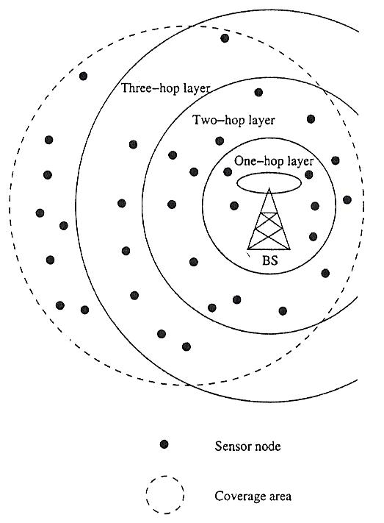
Design Factors
Layered Architecture
A single powerful base station (BS)
Layers of sensor nodes around (BS)
Layer i: All nodes i-hope away from BS
Applications:
In buildings: BS is an access point
Military: monitoring or tracking
Advantage: Short-distance, low power transmission

Slide 14
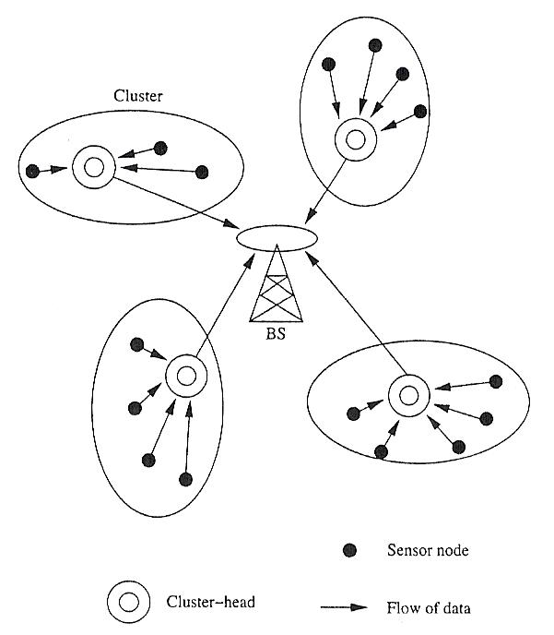
Design Factors
Clustered Architecture
Organize the sensor nodes into clusters
Each cluster is governed by a cluster-head
Only heads send messages to a BS
Self-organizing

Slide 15
Design Factors
Data Collection
Centralized data collection puts extra burden on nodes close to the base station. Clever routing can alleviate that problem
Clustering: data from groups of nodes are fused before being transmitted, so that fewer transmissions are needed
Often getting measurements from a particular area is more important than getting data from each node
Security and authenticity should be guaranteed. However, the CPUs on the sensing nodes cannot handle fancy encryption schemes.

Slide 16
Design Factors
Power Supply
battery powers the vast majority of existing platforms and so they determine the size of the majority of the nodes.
Alkaline batteries offer a high energy density at a cheap price. The discharge curve is far from flat, though.
Lithium coin cells are more compact and boast a flat discharge curve.
Rechargeable batteries: Who does the recharging?
Solar cells are an option for some applications.
Fuel cells may be an alternative in the future.
Energy scavenging techniques are a hot research topic (mechanical, thermodynamical, electromagnetic).

Slide 17
Applications of WSNs
Constant monitoring & detection of specific events
Military, battlefield surveillance
Forest fire & flood detection
Habitat exploration of animals
Patient monitoring
Home appliances

Slide 18
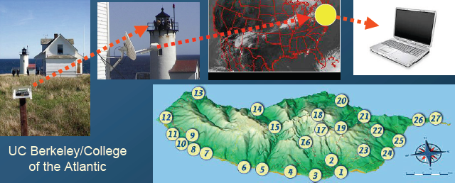
Applications of WSNs
Great Duck Island
150 sensing nodes deployed throughout the island, relay data, temperature, pressure, and humidity to a central device
Data was made available on the Internet through a satellite link

Slide 19
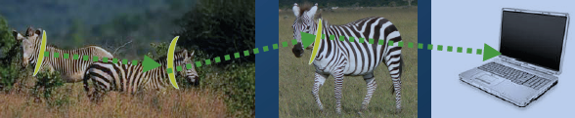
Applications of WSNs
ZebraNet: a WSN to study the behavior of zebras
Special GPS-equipped collars were attached to zebras
Data exchanged with peer-to-peer info swaps
Coming across a few zebras gives access to the data

Slide 20
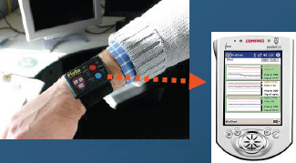
Applications of WSNs
Intel deployed a 130-node network to monitor the activity of residents in an elder care facility
Patient data is acquired with wearable sensing nodes (the ‘watch’)
The functionalities include:
Vital sign monitoring
Accident recognition
Monitoring the elderly

Slide 21
Applications of WSNs
The applications can be divided into three categories:
Monitoring of objects
Monitoring of an area
Monitoring of both area and object

Slide 22
Monitoring Area
Environmental and Habitat Monitoring
Precision Agriculture
Indoor Climate Control
Military Surveillance
Treaty Verification
Intelligent Arms

Slide 23
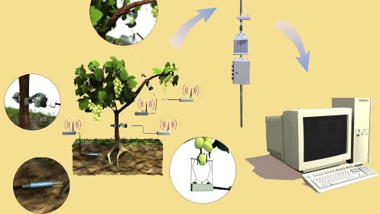
Precision Agriculture
Precision agriculture aims at making cultural operations more efficient, while reducing environmental impact.
The information collected from sensors is used to evaluate optimum sowing density, estimate fertilizers and other inputs needs, and to more accurately predict crop yields.

Slide 24
Monitoring Objects
Structural Monitoring
Eco-physiology
Condition-based Maintenance
Medical Diagnostics
Urban terrain mapping

Slide 25
Condition-based Maintenance
Intel fabrication plants
Sensors collect vibration data, monitor wear and tear; report data in real-time
Reduces need for a team of engineers; cutting costs by several orders of magnitude

Slide 26
Monitoring Interactions between Objects and Space
Wildlife Habitats
Disaster Management
Emergency Response
Ubiquitous Computing
Asset Tracking
Health Care
Manufacturing Process Flows

Slide 27
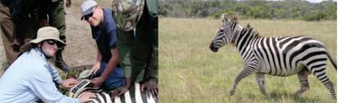
Habitat Monitoring
The ZebraNet Project
Collar-mounted sensors monitor zebra movement in Kenya

Slide 28
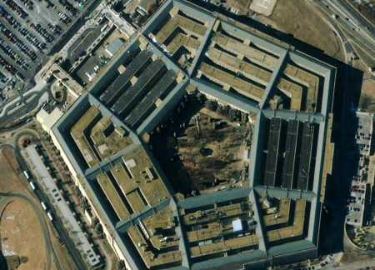
Future of WSN
Smart Home/Smart Office
Sensors controlling appliances and electrical devices in the house
Better lighting and heating in office buildings

Slide 29
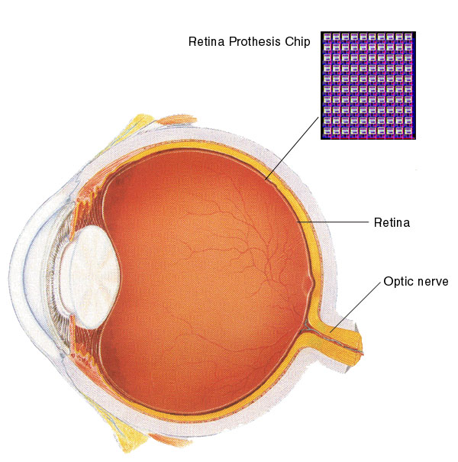
Future of WSN
Medical/Biomedical
Health Monitors
Glucose
Heart rate
Cancer detection
Chronic Diseases
Artificial retina
Cochlear implants
Hospital Sensors
Monitor vital signs
Record anomalies

Slide 30
Future of WSN
Industrial and Commercial
Numerous industrial and commercial applications:
Agricultural Crop Conditions
Inventory Tracking
In-Process Parts Tracking
Automated Problem Reporting
RFID – Theft Deterrent and Customer Tracing
Plant Equipment Maintenance Monitoring

Slide 31
Future of WSN
Traffic Management and Monitoring
Future cars could use wireless sensors to:
Handle Accidents
Handle Thefts
Sensors embedded in the roads to:
Monitor traffic flows
Provide real-time route updates

